Slide 1
EDU-SOLUTIONS
TUTORIAL + DEMo

Slide 2
Instructions
In order to set up the website for West Towson Elementary School, you must find a server to host your website.
The server host must support APACHE, PHP, JAVASCRIPT, JQUERY, MYSQL, HTML, CSS.
Alternatively for testing purposes, you can download a program called XAMPP to set the website up locally.

Slide 3
Setting up the database
You must create a database schema with your desired name
Included in the package are two .sql files. You must run the table creation script first before running the insert scripts.
You must edit the db_login.php by opening it in any text editor and changing the login credentials for your particular database.

Slide 4
demo
The demo will begin by showing you every single web page when viewed from ADMIN.
The demo will then continue to show you as STAFF, TEACHER, AND STUDENT
Essentially STAFF, TEACHER, AND STUDENT have restricted view of each other and limited privileges. (ex. Teachers can only view limited information on other teachers and update student’s grades)

Slide 5
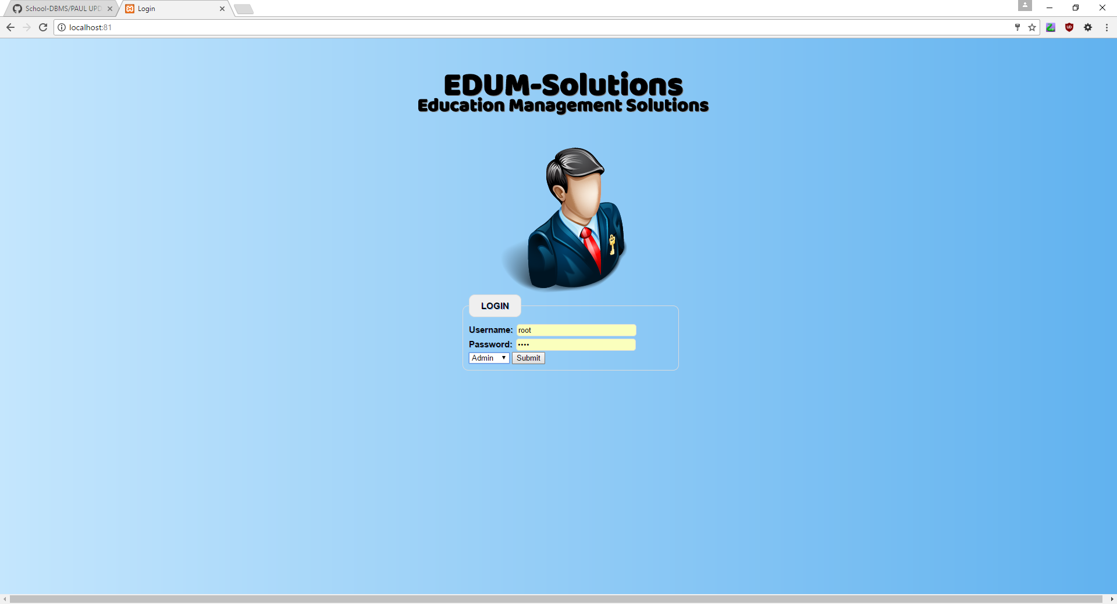
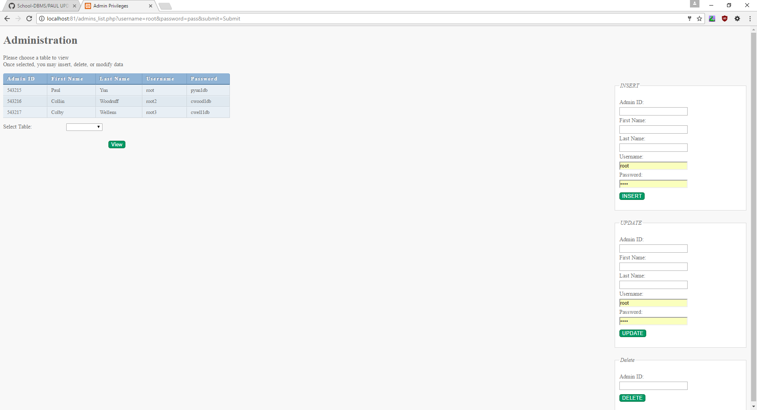
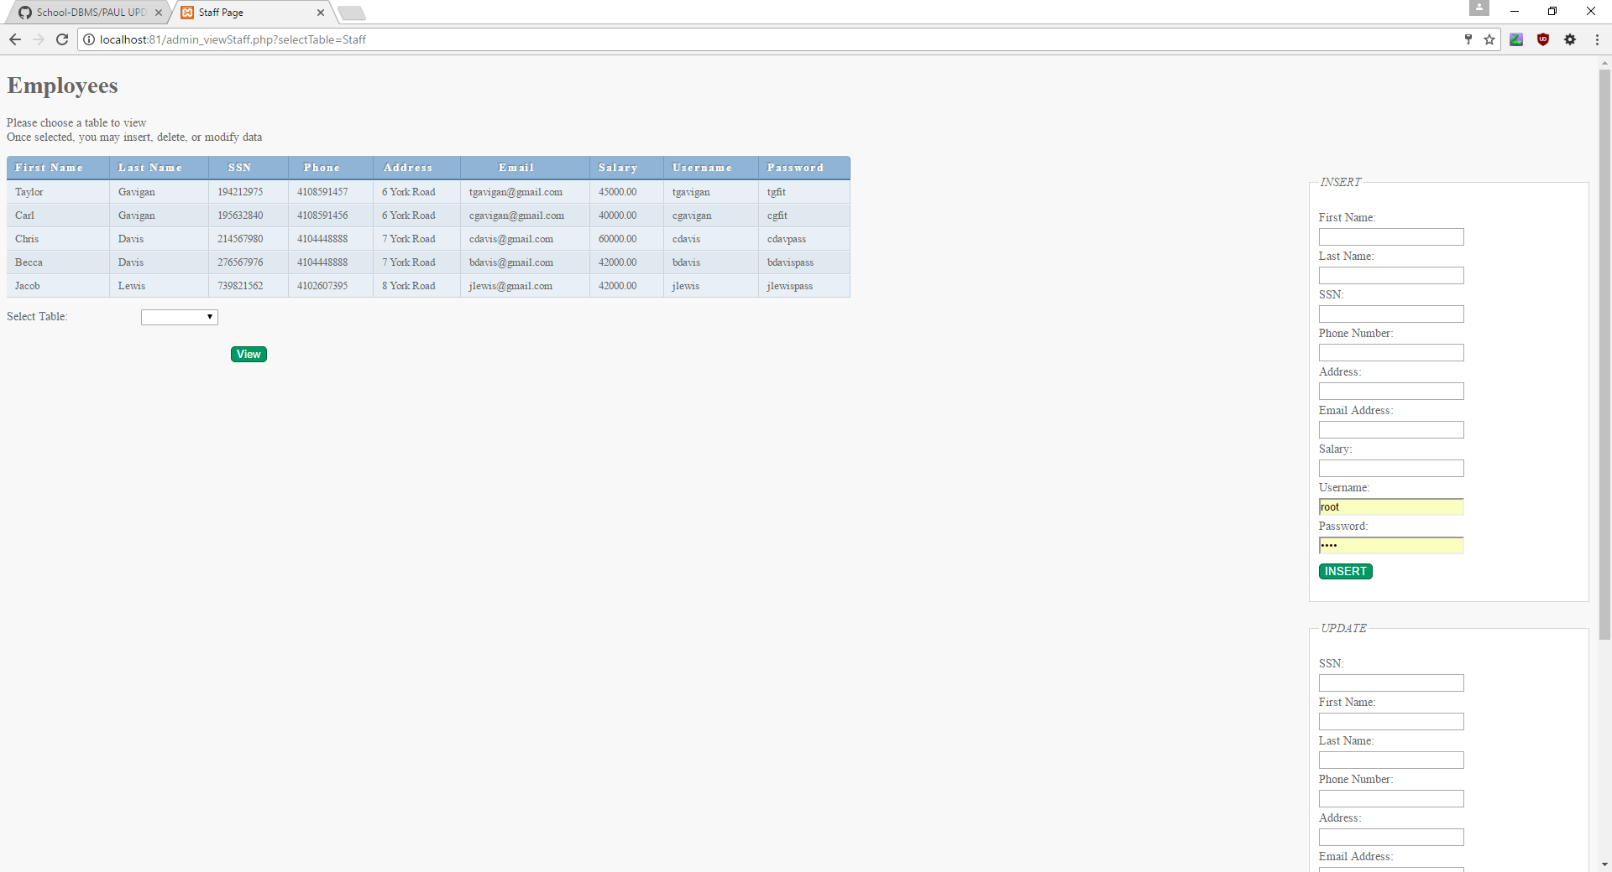
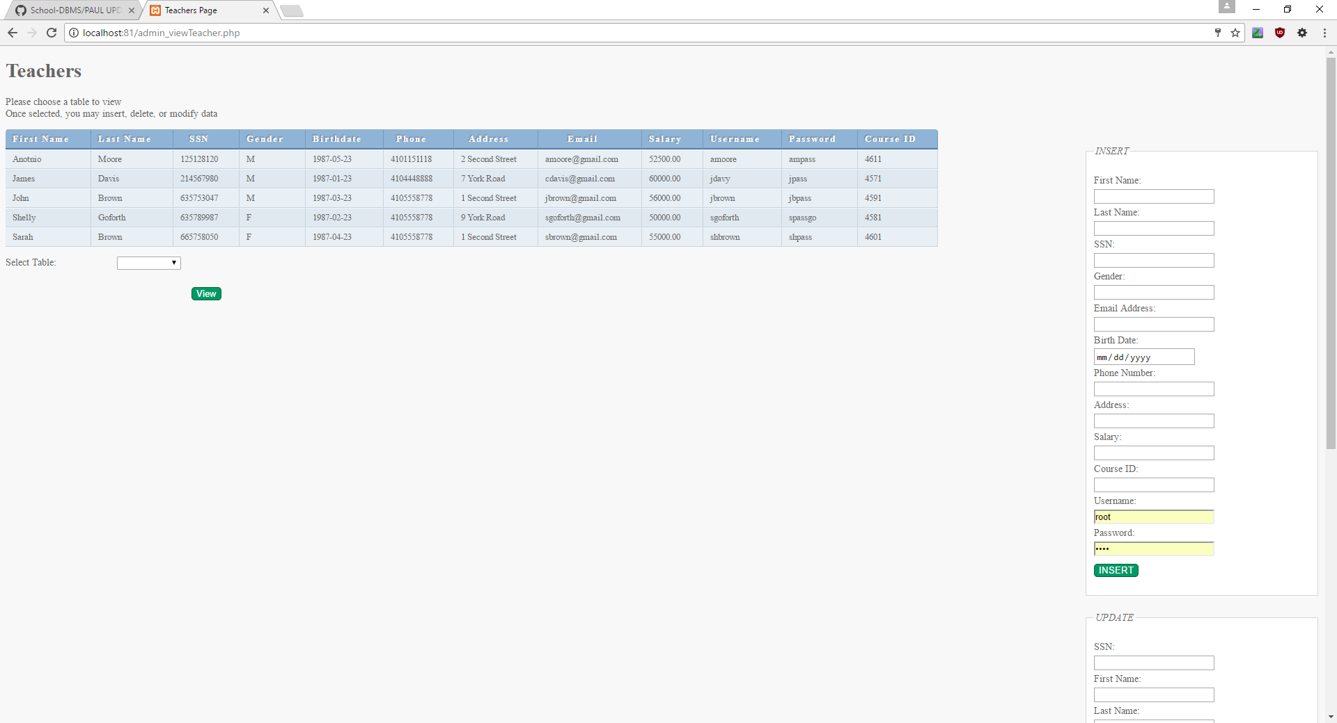

Slide 6
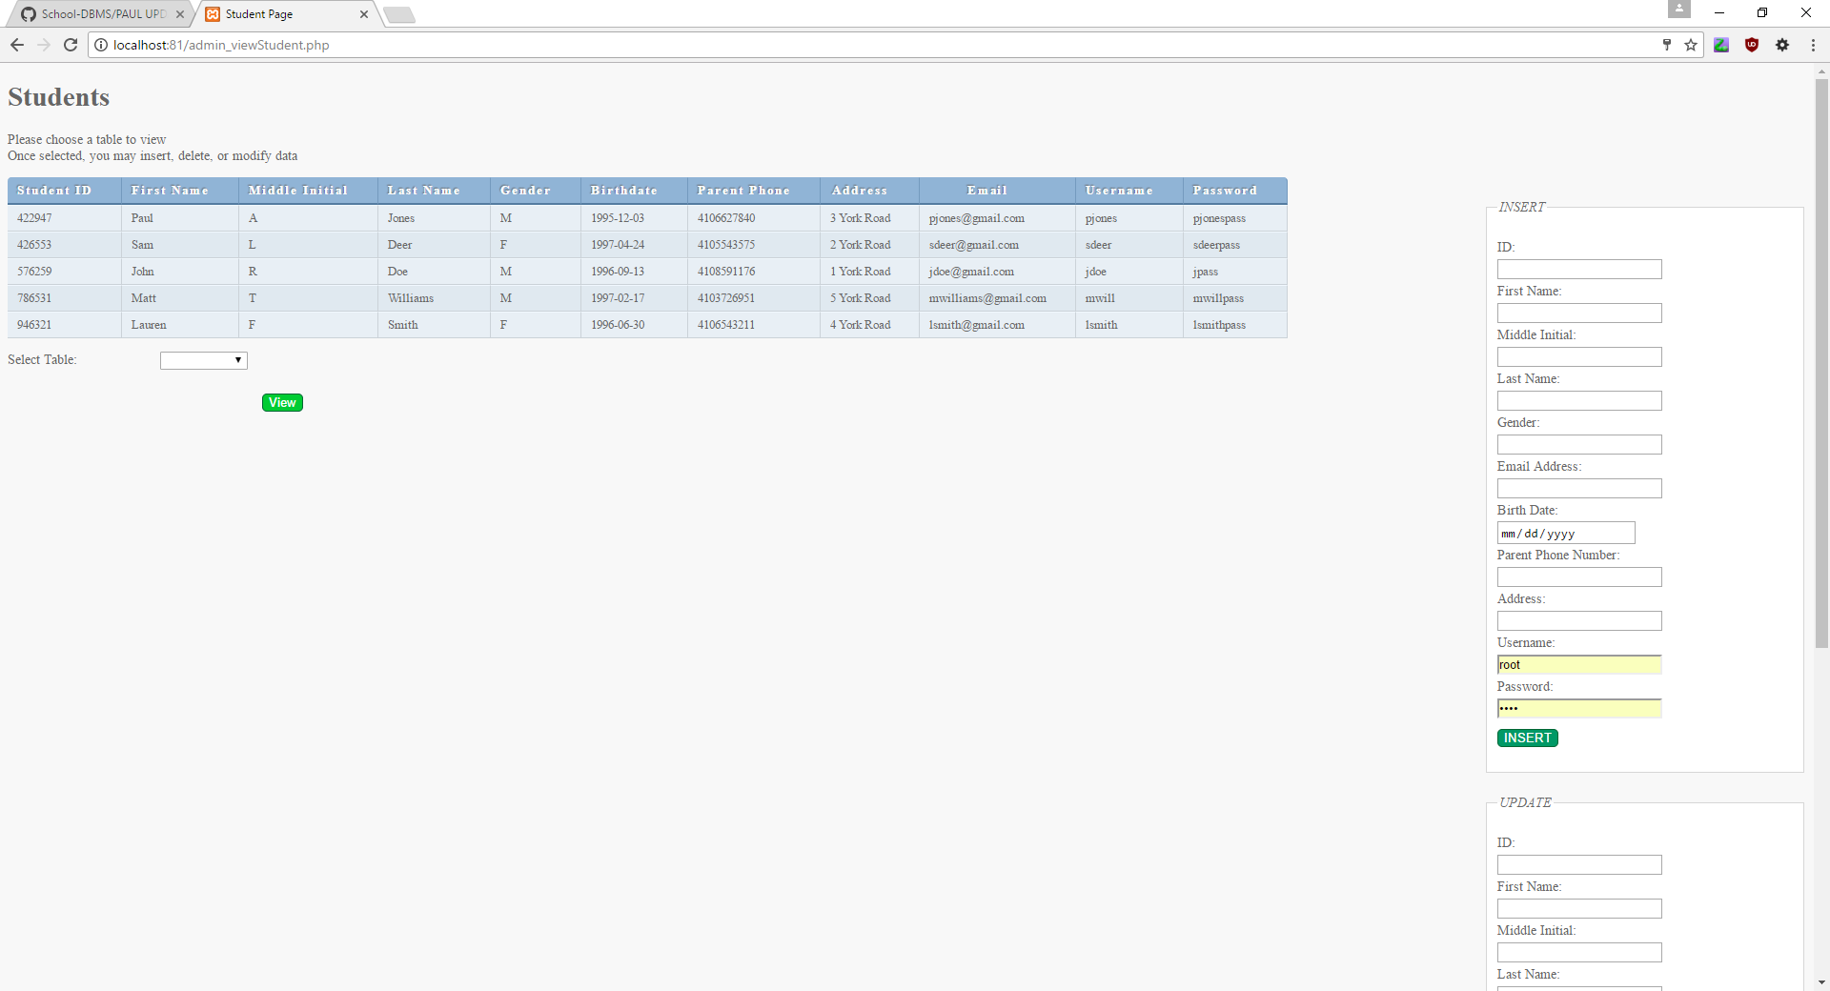
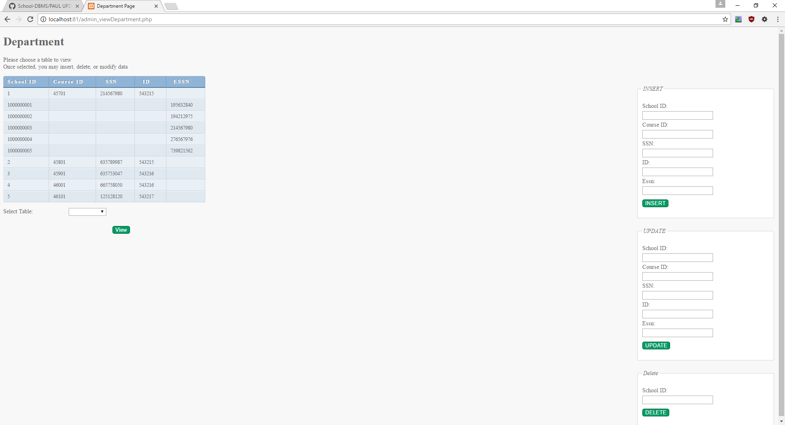
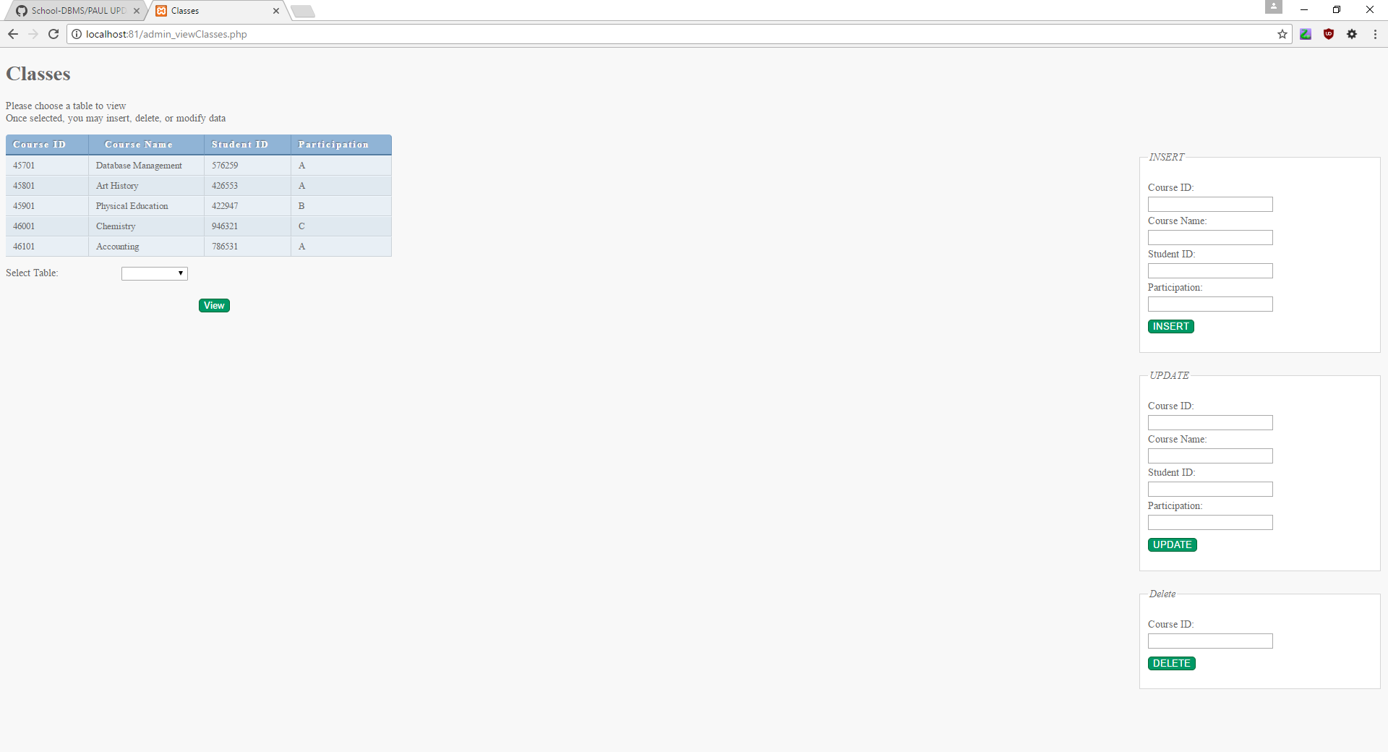
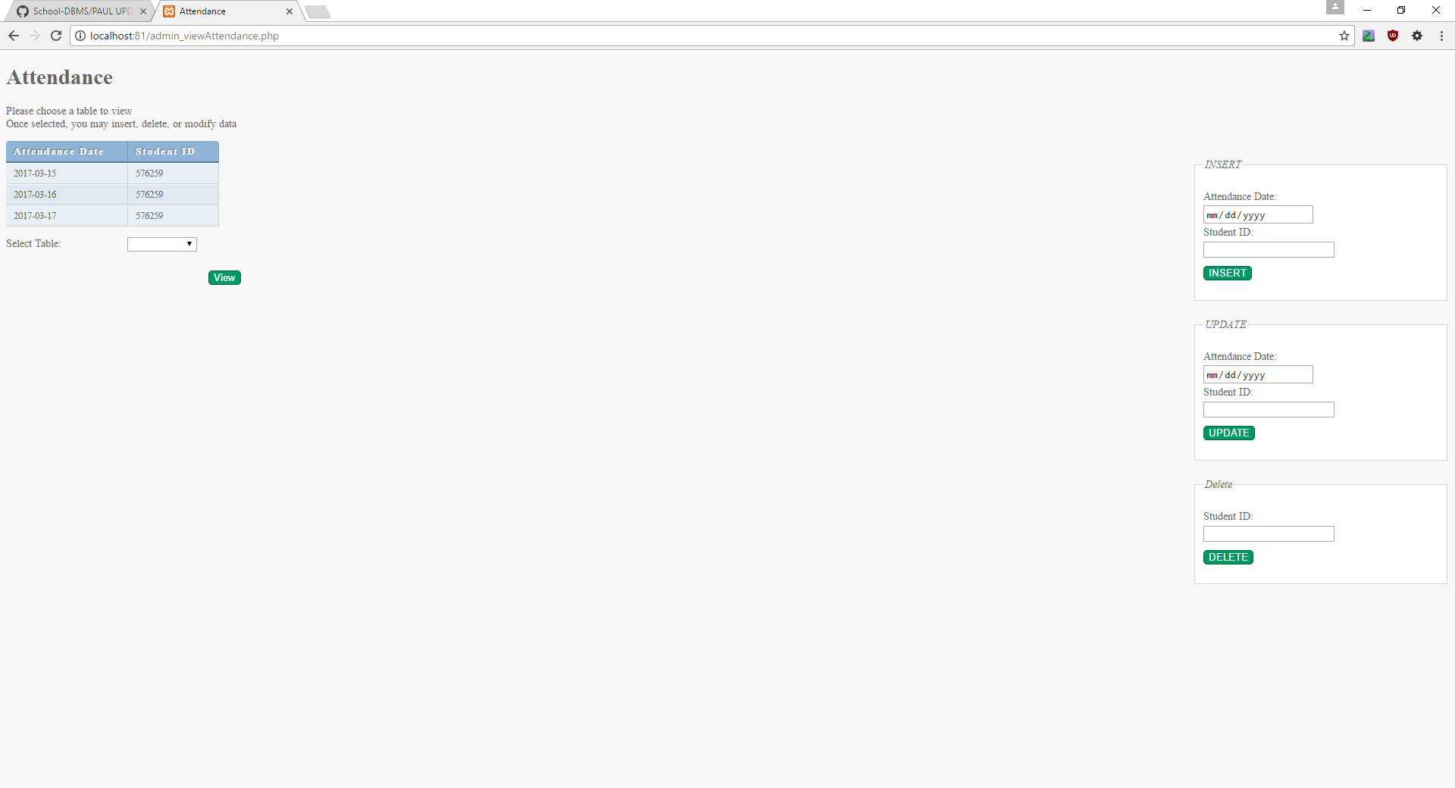

Slide 7
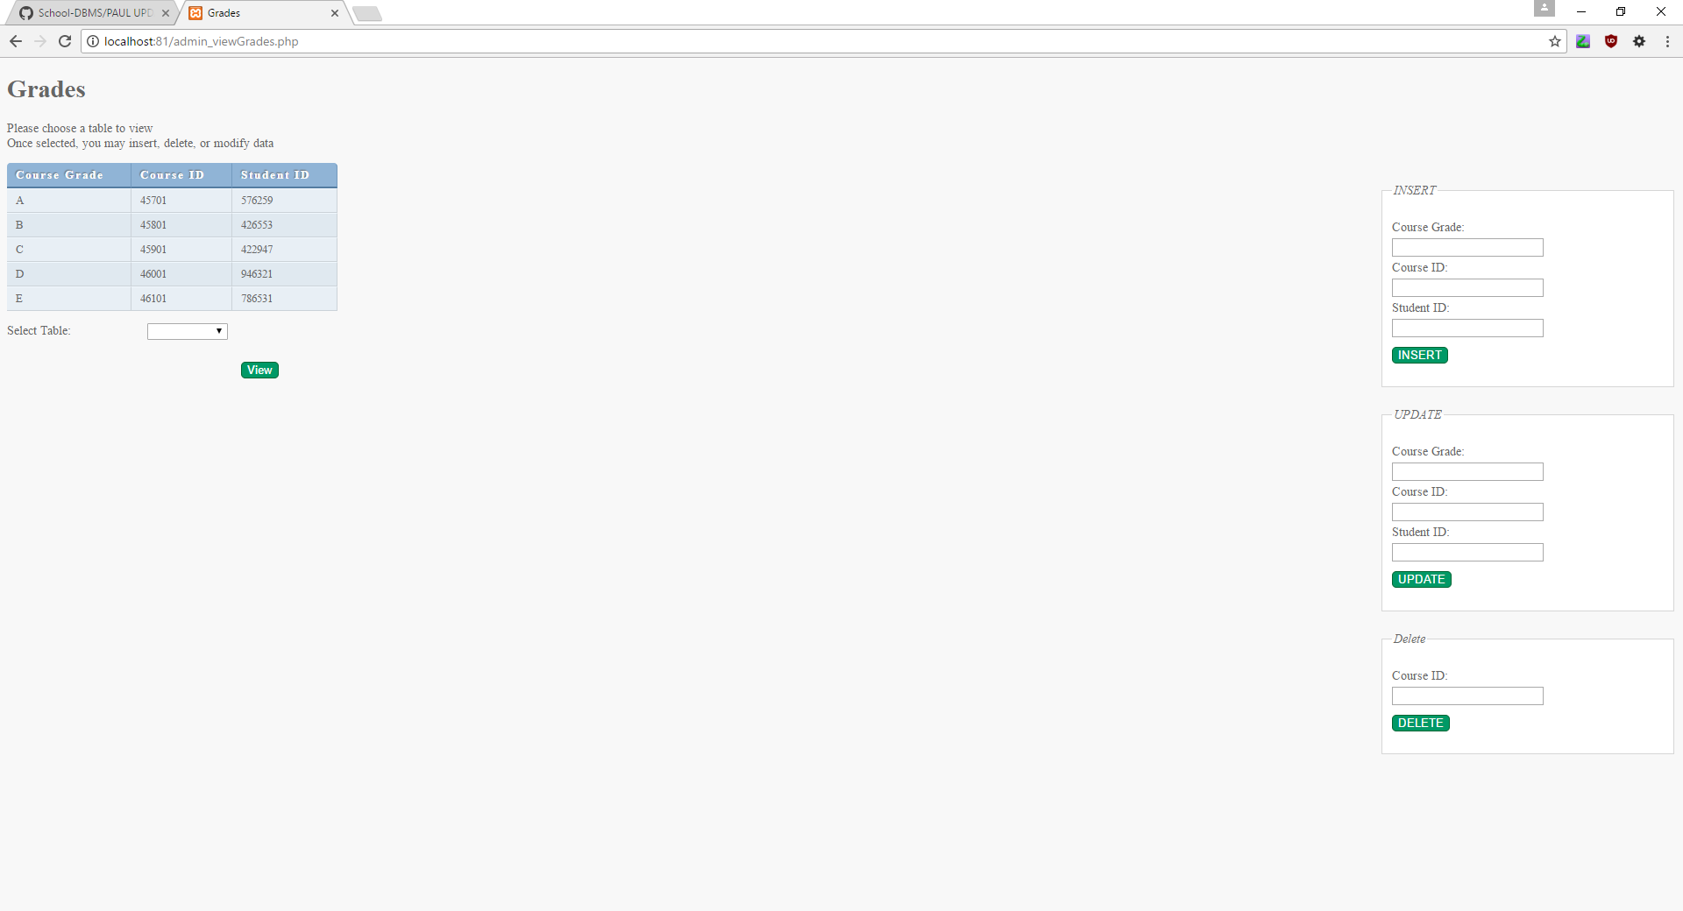
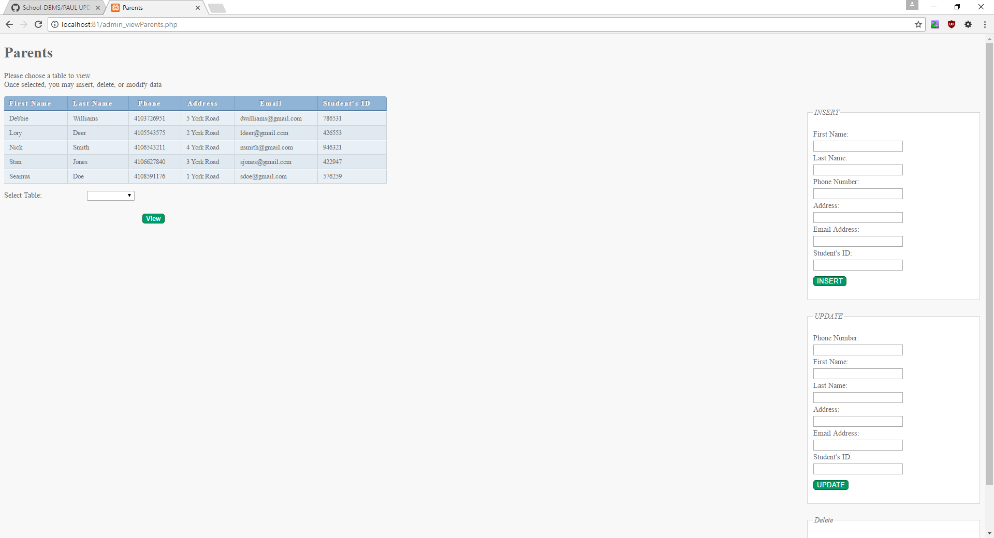
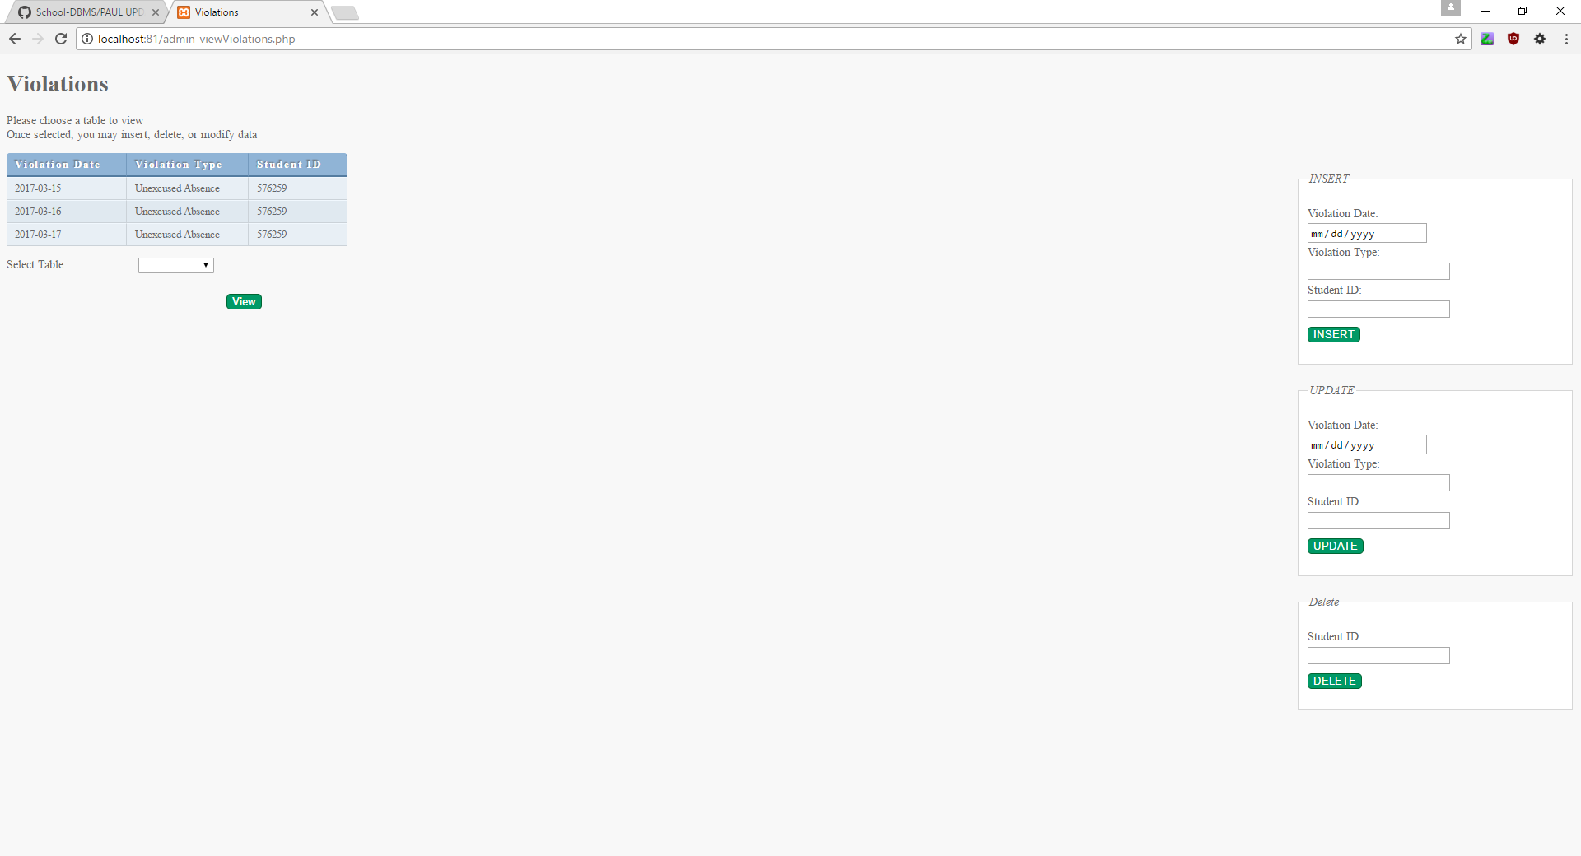

Slide 8

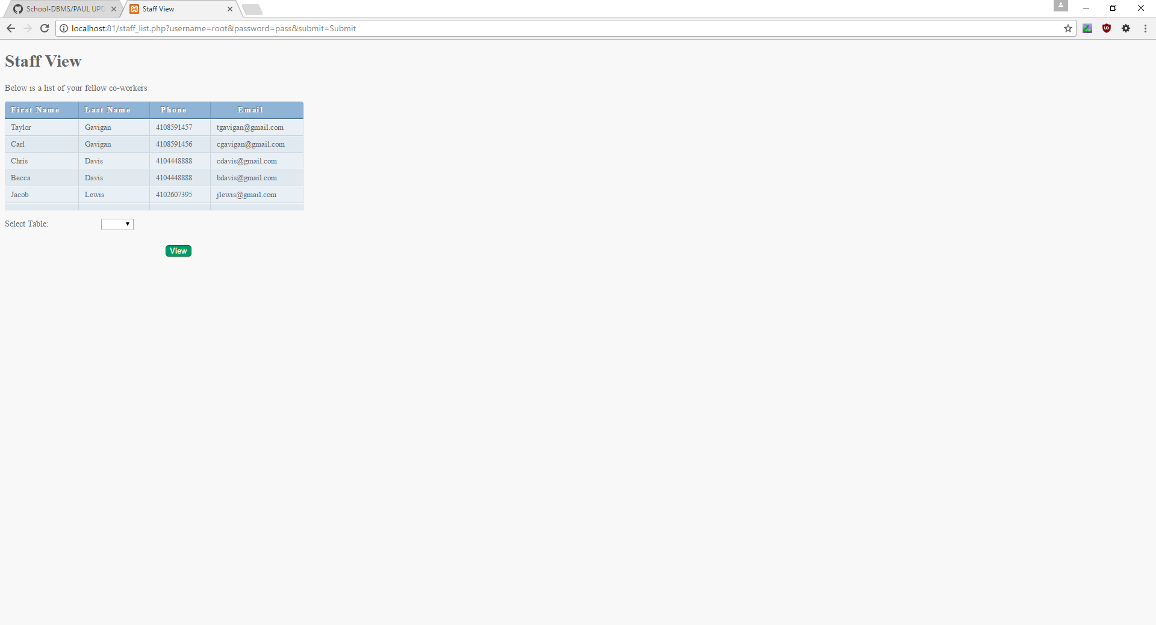

Slide 9

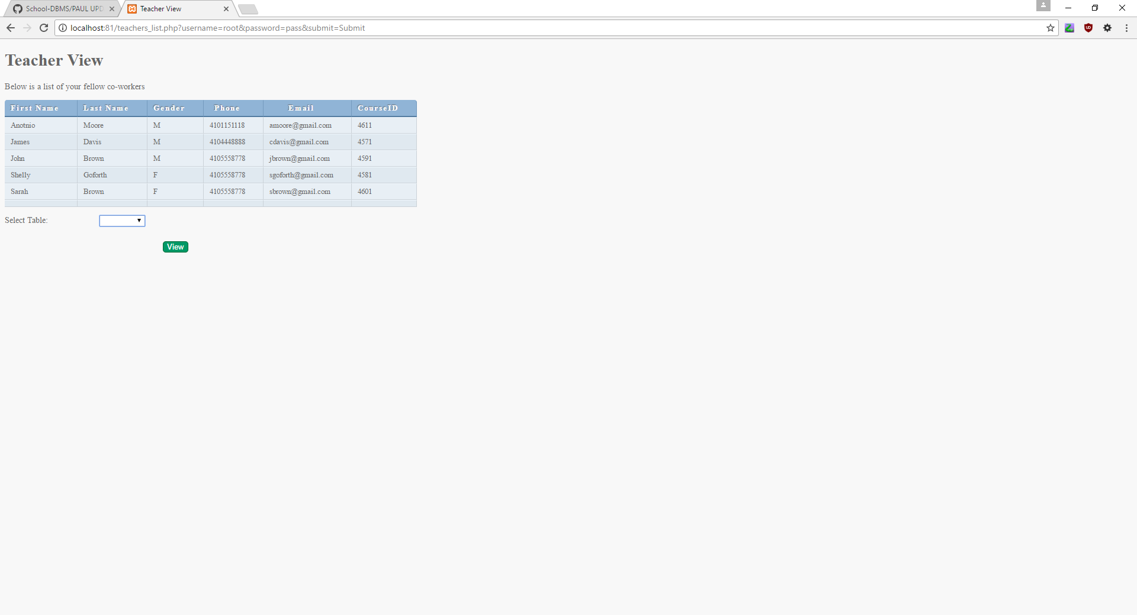
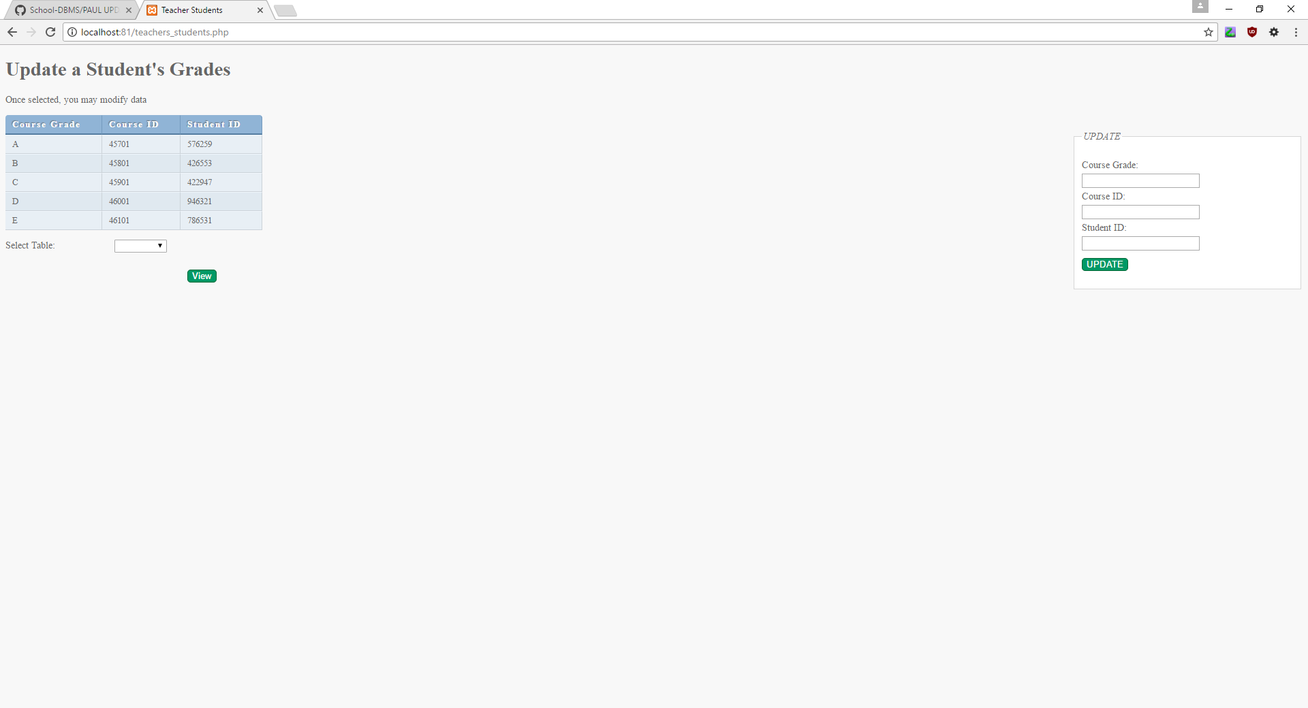

Slide 10


Slide 11
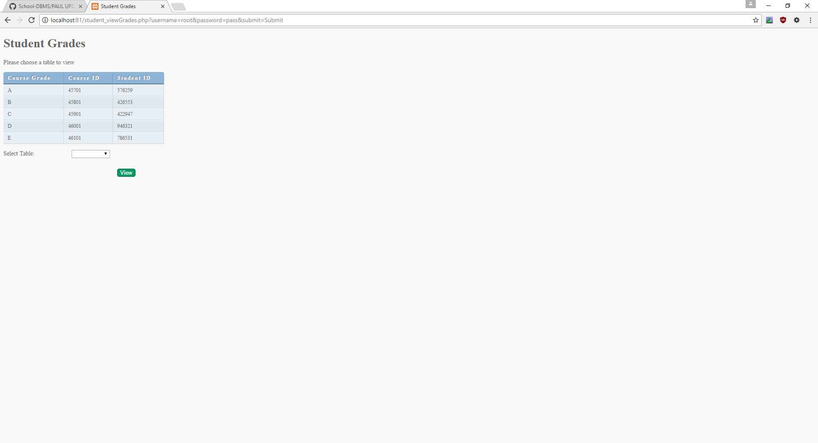
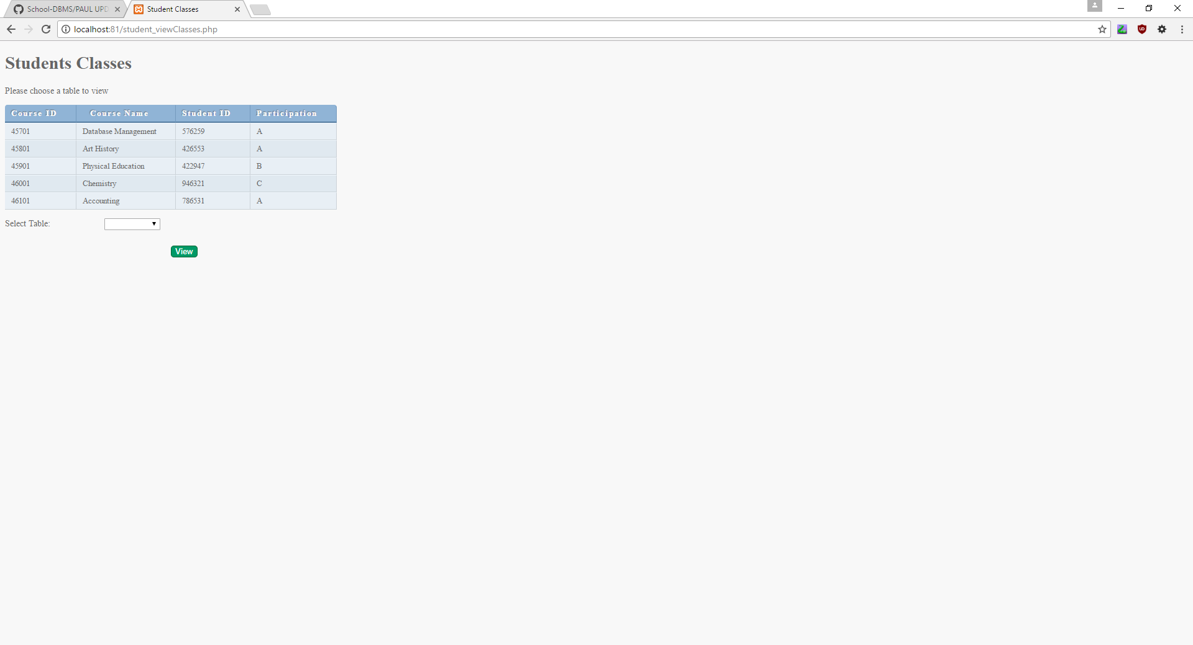
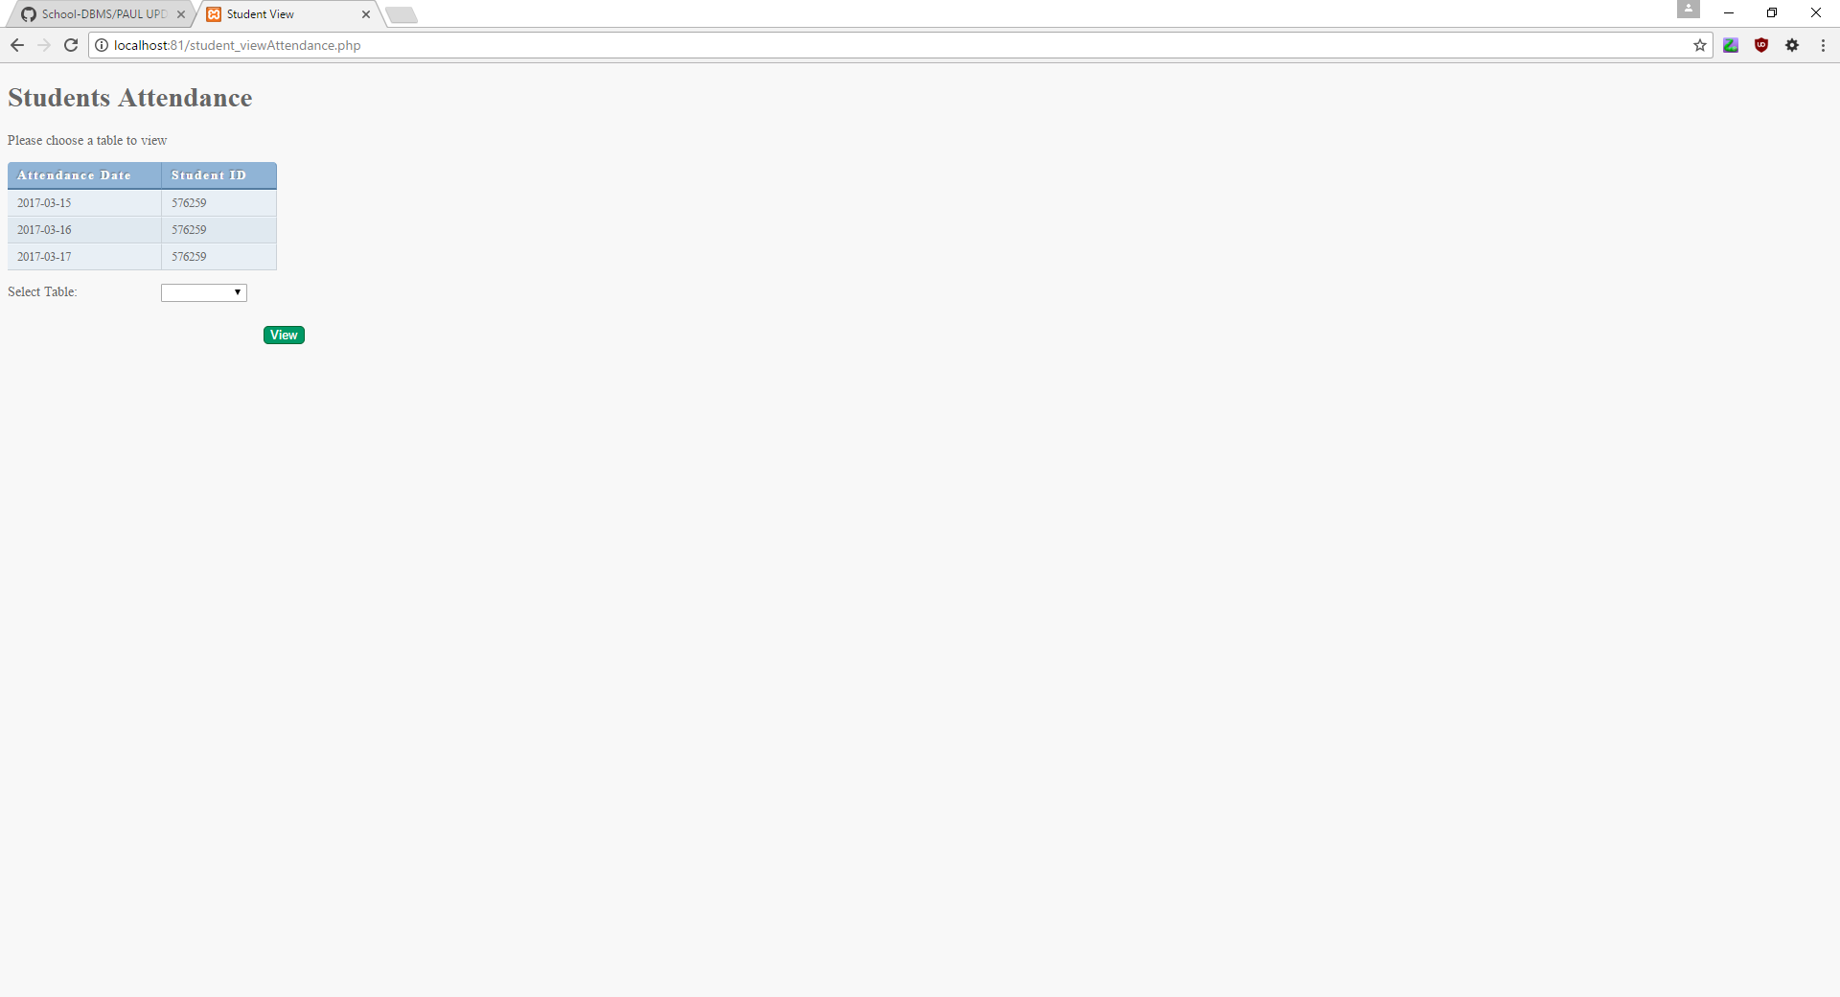
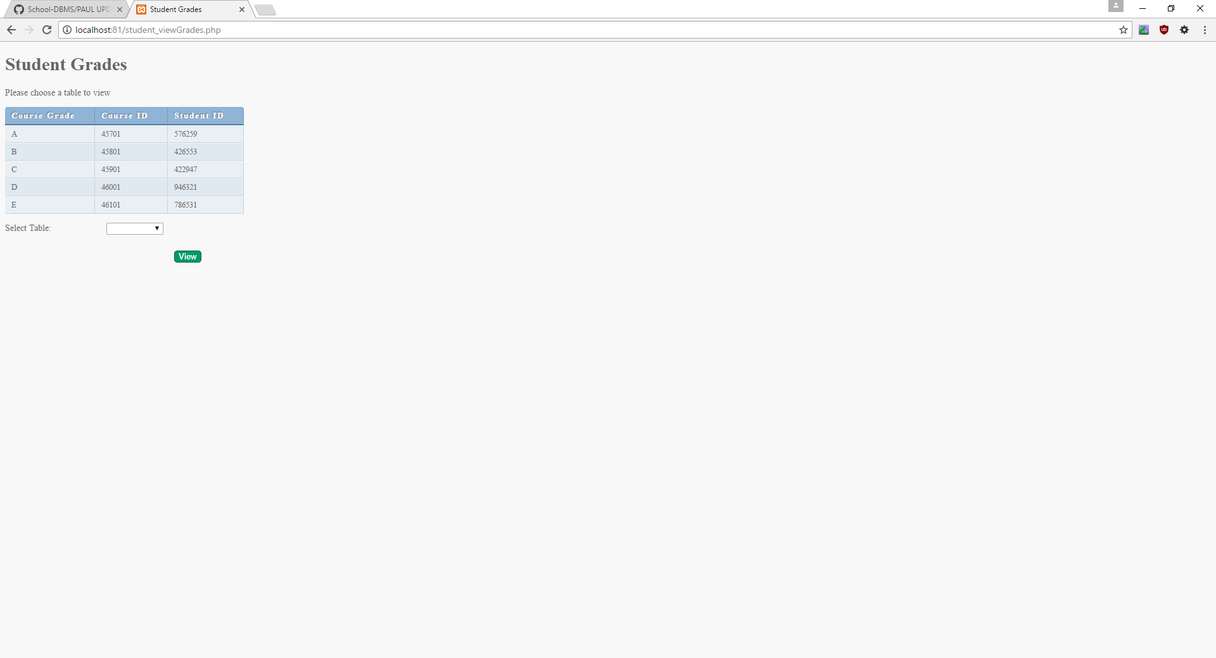

Slide 12
